Slide 1


Board Governance
May 20, 2010 (3:00 – 4:30 p.m.)
Facilitated by:
Mike Moyes
(CUcorp)
Sponsored by:
CREDIT UNIONS… A DRIVING FORCE OF COMMUNITIES

Slide 2

        Presented by:
        Mike Moyes
        CUcorp/MCUL
        mike.moyes@cucorp.com
        May 20th, 2010

Slide 3

Introduction
Director- Center for Board Excellence
Board Governance Consulting
Strategic Planning Facilitation
Field of Membership Expansion

Slide 4

Background
Director of Consulting- Utah League of CU’s
President/CEO- $265 Million Credit Union
SVP of Operations- $2.8 Billion Credit Union
Board Member for CUES & Community College

Slide 5
Agenda
Boards that Make A Difference by John Carver
Who are Board Members?
Limitations of Traditional Board Governance
Basic Principles of Board Policy Governance®
“Good to Great” Board Governance
Benefits for the CEO and Management Team

Slide 6
Who are Board Members?
Volunteer Board Members have been a pillar of the Credit Union movement for 100 years.
More than 61 Million Americans donated their time last year. (U.S. Bureau of Labor)
This totaled 8.1 Billion Volunteer Hours.

Slide 7
Who are Board Members?
Michigan and the Midwest region led the country in Volunteer rate at 31.1% of all adults. Congratulations!
There are 107,501 Volunteers serving at Credit Unions as Board and Committee Members.

Slide 8
Who are Board Members?
Who are these amazing people?
I commend them for giving of their time.
They help build our communities and improve lives.

Slide 9
Who are Board Members?
They are “People helping People”.
They play a part in helping young people build their credit with a strong foundation.
They help members get their first car, home, and build their retirement.

Slide 10
Who are Board Members?
Credit Union volunteers are extremely loyal and dedicated.
In other industries, 35% of volunteers drop out of service each year.
This greatly inhibits the productivity of the organization they serve.

Slide 11
Who are Board Members?
Average number of board members is 7.
For Federally chartered credit unions, Boards may have between 5 and 15 board members.
The board must be comprised of an odd number of members.

Slide 12
Better Board Governance
In today’s difficult economy, we realize that what worked yesterday, may not work today.
New Paradigms make us continually look to improve and stretch for a competitive advantage.
Many credit unions and other businesses around the world have found greater success and discovered a better, results-driven Governance Model.

Slide 13
Better Board Governance
Dr. John Carver’s groundbreaking book, “Boards that Make a Difference”, has revolutionized Board Governance.
This Governance model is being used by some of the largest and most successful credit unions in Michigan and the U.S.
The model has been highlighted at MCUL, CUNA and CUES Conferences & in Credit Union Times & Credit Union Journal.

Slide 14
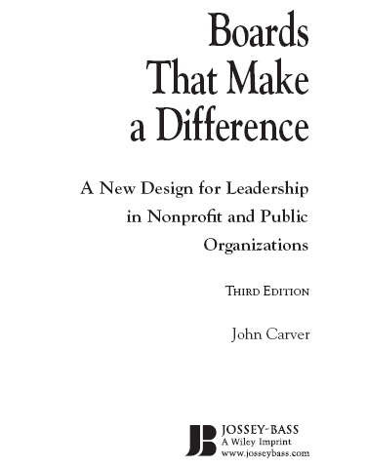

Slide 15
What is Carver Board Governance?
The Model is a theory and set of practices for board of directors and CEO’s.
It allows you to enhance your ability to set direction for the credit union.
Policies are re-written detailing the Board and the CEO’s role and responsibilities.
The Policies can be written in great detail or less detail depending on your credit union’s culture.

Slide 16
What is Carver Board Governance?
It allows the Board and CEO to focus on the purpose or the mission of the credit union.
Your credit union was organized by the members for their benefit.
The Model allows you to focus more on how members will be served and what benefits they will receive.

Slide 17
The Carver Outline…
Leadership by Governing Boards: A Vision of Group Accountability
Policy as a Leadership Tool: The Force of Explicit Values
Focusing on Results: The Power of Purpose
Controlling Ethics and Prudence: What’s Not OK, Even if it Works
Strong Boards and Strong Executives
Notes:
Leadership by Governing Boards: A Vision of Group Accountability
This chapter covers much of what was highlighted in the previous slide. Carver set’s the foundation for what is to come which is a translation of modern management principals that addresses the unique circumstances of boards and a restructured paradigm for governance.
Policy as a Leadership Tool: The Force of Explicit Values
Chapter two examines Carver’s argument that redefinition of policy and policy making can result in the opportunity for greater strategic leadership. We can recognize that management practices have been improved and refined over the years. Modern governing will enable a board to lead better. Boards don’t need to be experts at running the credit union, but they do need to be expert at leading the organization and governing effectively in their roles. Carver redefines policy as values and perspectives, guiding principals and argues that if a board moves away from detailed and event-specific decision making and toward values and perspectives, that they are more capable of delegating the actual event by event decision making safely and profitably to staff. By attending to policy content, a board can gain more control over what matters in the organization and be less likely to get lost in the minutia. In this chapter, Carver intoduces four policy categories: Ends, Executive Limitations, Board Management Delegation and Governance Process.
Designing Policies That Make a Difference: Governing by Values
Chapter three looks at the traps in policymaking and the characteristics of effective policy making. Carver shows how boards can create better control with shorter documents and demonstrates how the revered practice of approving budgets, plans, and other administrative tasks becomes unnecessary when boards enact policies that make a difference. Carver asserts that these administrative practices cripples strategic leadership. Nested set-broad to specific..
Focusing on Results: The Power of Purpose
Chapter four begins the examination of the four policy categories, beginning with Ends. The Ends policies direct the most critical feature of any organization- the end results. In these policies, the board makes clear what the organization is for-not what it does. It is a more rigorous interpretation of what is typically considered a companies mission. With the ends, the board should seek to ask itself: what good shall we accomplish, for which people or needs, and at what cost?” Differentiation between ends and means are discussed at length. Organizational activities are always means- external outcomes are always ends. The chapter also goes into characteristics of good ends statements, some of which are succinctness, strict results focus, and proper categorization.
Controlling Ethics and Prudence: What’s Not OK, Even if it Works
Chapter five discusses how the board is accountable for its staff members achieve these ends and how they conduct themselves. Carver also considers how the board can safely keep out of staff business, yet still be accountable for the conduct of business. He asserts how relatively few executive limitation policies can give board and CEO the freedom to be innovative and attentive to their respective jobs. Executive limitations are about what the executive can’t do.
Strong Boards Need Strong Executives
Chapter six explores the relationship between the board and the CEO or Board-management delegation. Accountability is further explored through the discussion of method of monitoring and evaluating the CEO. This chapter gives direction on where the board should be “hands on” and where they need to be “hands off”. For instance, Carver states the board should be hand’s on with regard to establishing the limits of the CEO’s authority to budget, administer finances and compensation. He indicates the board should be hand’s off in areas of determining staff development needs, terminations and promotions.

Slide 18
The Carver Outline…
Officers and Committees: The Chief Governance Officer and Other Divisions of Board Labor
Policy Development by Levels: Adding Details Judiciously
Making Meetings Meaningful: Creating the Future More Than Reviewing the Past
Maintaining Board Leadership: Staying on Track and Institutionalizing Excellence
Notes:
Officers and Committees: The Chief Governance Officer and Other Divisions of Board Labor
In the organization of board work, officers and committees emerge as official subdivsions io the whole board. Strategic leadership is best served when this division of labor does not jeopardize the board’ wholeness or confound it’s linkage with management. Particular attention is given to the principals of board committees and to the chairs role- as the Chief Governance Officer. This chapter delves deep into the roles and rules for a board’s officers and committees.
Policy Development by Levels: Adding Details Judiciously
Real life policies are presented in this chapter to illustrate discrete policy topics. Specifically, Carver demonstrates the flow of policy creation from the global to the more detailed levels- or how policies are developed through a number of graduated levels (nesting bowl)
Making Meetings Meaningful: Creating the Future More Than Reviewing the Past
After designing the technical framework to meet governance challenges, a board must now do the hard part: making it work with real people and real situations. Too often board dreams are constrained and thwarted by crowded, meandering and pressing agendas. Board goals and dreams are too often regulated or determined by their agendas. This chapter considers how board members can ensure their agendas and discussions serve their dreams.
Maintaining Board Leadership: Staying on Track and Institutionalizing Excellence
Provides both challenges and counsel for attaining and maintaining successful strategic leadership on a governing board. A number of strategies are presented.

Slide 19
Shortfalls of traditional Board Governance
Time spent on the trivial
Reading reams of documents
Long-running meetings that accomplish little
Committees that are duplication of what management does
Micromanaging in administration
Unclear boundaries of authority

Slide 20
Shortfalls of traditional Board Governance
Reactivity vs. Proactivity
Executive committee as de facto Board
Confusion about direction and priorities
Rubber stamping
No clear method to evaluate the CEO
Short-term bias

Slide 21
Shortfalls of traditional Board Governance
Most boards are trapped in an inadequate design of their jobs- they mean well!
Roles are not clearly defined
The problem is process, not people
Staff in control of board meeting agendas
Complete overload

Slide 22
Satisfied Board’s and CEO’s
Survey’s show that successful and satisfied CEO’s and boards have several things in common:
Focus on Strategic Planning (The Big Picture)
Knowledge of CEO and Board Roles
Detailed Policies
Member Service focus
Community Representation

Slide 23
Satisfied Board’s and CEO’s
Survey’s show that successful and satisfied CEO’s and boards have several things in common:
Clear Agenda
Communication
Lack of Micromanaging
Common Trust
Focus on Priorities

Slide 24
Better Board Governance
“Reduced to its minimum, the purpose of governance is to ensure, on behalf of members, that a credit union achieves what it should achieve while avoiding those behaviors and situations that should be avoided.”

Slide 25
Dr. Carver’s Broad Assessment
“Most of what the majority of boards do either does not need to be done or is a waste of time when done by the Board. Conversely, most of what boards need to do for strategic leadership is not done.”
Notes:
Reality suggest we need a new methodology. As we touched on before, management as a science has had much more focus and development than governance. Carver’s methodology originated about thirty years ago, which is relatively young considering other models in the field of industrial behavioral science.
It’s about time we revolutionized the way we work in the board room to embrace modern practices. I encourage you to view Carver’s model as a way to understand how to operate more efficiently. A way to allow your CEO to operate the credit union more efficiently. And a way to partner with the CEO to bring your credit union to a whole new level. What you do or don’t do in the board room affects your membership, your community, and the internal staff of the credit union.
This is a way to lead your credit union to desired outcomes more effectively.

Slide 26
Benefits of Carver Board Governance
Boards can be “forward-thinking”
Helps the Board and CEO avoid lawsuits
Focusing on Results for the Member
Boards focus more on Key Issues and Institutionalizing Excellence
It makes board meetings more meaningful by spending time creating the future more than reviewing the past

Slide 27
Benefits of Carver Board Governance
Board Governance requires that the board provide Vision. To do so, the board must first have an adequate Vision of its own job.
Governance is an approach to the job of governing that emphasizes values.
It allows for the empowerment of both the Board and the CEO.

Slide 28
Types of Governance Policies
Observing the principles of the Governance Model, a board crafts its values into policies of four types including:
Ends Policies
Executive Guidance and Limitations
Board- CEO Delegation
Governance Process

Slide 29
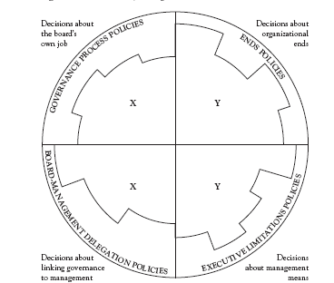
Board Policymaking

Slide 30
What types of Policies are written?
1. Ends Policies:
The Board defines which needs are to be met, for whom, and at what worth. Written with a long term perspective, these policies embody most of the board’s part of long range strategic planning.

Slide 31
What types of Policies are written?
2. Executive Guidance and Limitations Policies:
The Board and CEO establish the boundaries of acceptability within which the CEO and management team operates. These can be as restrictive or empowering as needed.

Slide 32
What types of Policies are written?
3. Board-Management Delegation Policies:
The board clarifies the manner in which it delegates authority to the CEO as well as how it evaluates CEO performance.

Slide 33
What types of Policies are written?
4. Governance Process Policies:
The board clarifies its philosophy, its accountability, and specifics for its own job as the governing body of the credit union.

Slide 34
What is a Board’s Duty?
Hire, evaluate and retain a good CEO
Provide strategic direction to the CEO
Establish, maintain and operate within governance policies
Provide fiduciary stewardship for and on behalf of the member-owners
“Governance Policies help with, but do not replace these board of director duties.”
Notes:
Dave facilitates this discussion with audience participation…….

Slide 35
Moving Toward Solutions
Framing the Governance Challenge
Inadequate Prescriptions
  More or less involvement
  Board as staff watchdog
  Board as cheerleader
Proper Prescriptions
  Board as manager (of the CEO)
  Board as planner (with the CEO)
  Board as adviser (for the CEO)
  Board as communicator (with the CEO)
  Board as Trustees (for the members)
  Board Holism (for the CEO)
Notes:
Framing the Governance Challenge
Inadequate Prescriptions
At some level, boards and executives are well aware of the historical deficiencies in the ways they operate. Many have offered advice for board practices all along. Somehow the prescriptions, though rational, have fallen short. Because few have been based in a complete conceptual model, prescriptions have been largely piecemeal.
More involvement
Some have said boards should be more involved directly I the work of organization, the premise being boards operating at a distance can be too detached. This can result in a hyperinvolved board-and the board agenda is likely to be drawn out with committee work being on the heavy side.
Less involvement
This board is characterized by brisk, business only meetings with involvement with relevant facts-often the financial ones. Committee work may be light and the meetings will be more brief in nature.
Board as staff watchdog
Certain rx’s state boards should keep a close eye on staff activities. This results in limited empowerment of staff on all levels. Watchdog boards often get very involved in staff activities, approving everything from how much to spend on staplers, what color the new sign should be, etc. Watchdog boards may see themselves as protecting staff from administrator..
Board as cheerleader
The hallmark of the cheerleader board is trust. Premise is that staff is basically honest and capable so the board must be supportive and cheer them on. This is the other spectrum of watchdog-so they may excessively rubberstamp and not ask hard questions because “they’re the experts- we’re just volunteers”
Proper Prescriptions
Board as manager (of the CEO
Again, the board is not an upward extention of management, but a downward extention of the owners. As such, they are the manager of the CEO.
Board as planner (with the CEO)
Boards work with the CEO to plan elements of personnel, finance, etc rather than engaging in impelementation.
Board as adviser (for the CEO)
Boards are comprised of experienced people and as such they should work collectively with the CEO as an advisor if necessary.
Board as fundraiser (for the CU)
Board as communicator (with the CEO)
Some inadequate rx’s have the board communicating better, particularly with staff, the premise being the organization will have abetter process and ultimately product. The board needs to communicate and improve on this with the CEO. The path to better governance does lie in better human relations- but this needs to be improved with the CEO and amongst themselves.
Board as Trustees (for the members)
The board are trustees of the membership and as such must look out for the well-being of the members and what the members want and need.
Board Holism (for the CEO)
In short- a holistic board is a single organizational position. Board officers are not powers unto themselves. If the board works well, and the board chair does his or her job- the CEO performance will follow. The board chair- or Chief Governance Officer in the carver model- doesn’t have the authority to venture beyond what the board actually says. Ultimatey, this principle can be viewed as the board has one voice. When a decision is made- that is the decision and talking bad about it if you were a board member that didn’t agree, with the decision, is counterproductive.

Slide 36
Policy as a Leadership Tool
Reinventing the Meaning of Policy
Policies as Values and Perspectives
Policy Development by Levels
Adding Details Judiciously
Notes:
Dave….

Slide 37
Designing Policies that make a difference
Get Rid of Unnecessary and Outdated Detail While Being Comprehensive
Make Policies Visible, Explicit, Literal, Active, Properly Classified, Centrally Available and Brief
Move Broad to Specific and Large to Small (Prioritize)
Set Board Policy, not Staff Policy
Hold CEO Accountable for Staff Policies
Notes:
Dave….

Slide 38
Focusing on Results- Ends and Means
Define Mission & Purpose
Resist the Captivating Allure of Organizational Events/Issues
Stay Outward Focused
Transaction With the Environment
If not “Ends”, it is “Means”
The Mask of Commendable Activities, Conditions, Structure, Technology, Etc.
Notes:
Define Mission & Purpose
Having a “mission” is great, but within a mission statement you risk prescribing “how” to get there. The detriment here is stifling creativity and innovation. Asking, “What good shall we accomplish, for which people or needs, and at what cost”, helps define a more comprehensive purpose. Truly knowing purpose helps drive the right results.
Resist the Captivating Allure of Organizational Events/Issues
Typically, a high percentage of time is spent on internal matters. Even when the subject is related to what appear to be applicable programs or services, the focus tends to be on personnel, financial or other administrative matters. Board discipline must be designed to keep the board on task- outside of internal matters and on the larger context.
Stay Outward Focused
Look at the organization’s environment as the setting for analysis and debate.
Transaction With the Environment
Ask what good you should accomplish for membership- what is the actual and intended outcome?
Seek to find the intended and actual results you want- and determine for whom? In your membership, will it be for the overall membership, or certain segments?
And as board members, what are the cost of those results or of those results for a particular person or segment of your membership. This is a transaction – what are you giving, what does it cost?
If not “Ends”, it is “Means”
End’s and means can be confusing at first blush. Carver spends a lot of time on this but a shortcut is it’s not a mean’s to an end. Ends are not just outcomes- but results coupled with who they affect and at what cost. If it doesn’t fall in this category, it is considered means. A hint is that any organizational activities are considered means.
The Mask of Commendable Activities, Conditions, Structure, Technology, Etc
Well intended or reasonable actions are often confused with ends. For instance, more number and quality of handouts at a training session-high staff morale-cutting edge technology…all a means. They are not the reason the organization exist. Boards should focus on the Ends.

Slide 39
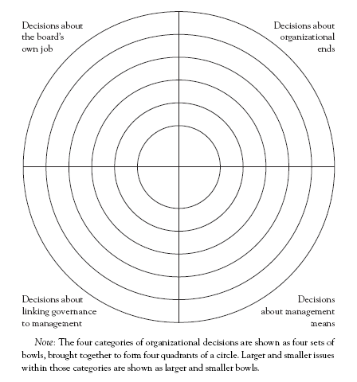
The
Board
Policy
Circle

Slide 40
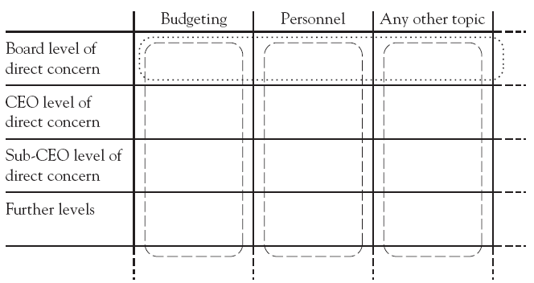
Decision Levels

Slide 41
Compelling “Ends” Policies
Strict Results Focus
Succinctness
Active Board Involvement in “Ends”
Accountability to Owners/Members
Properly Categorized
Theme and Backbone of the Credit Union
Stark and Direct
Global Purpose, Followed by Policies About Results, How Members Benefit, Pricing, Etc.
Integration With Long-Range Planning
Evaluating Ends With Key Performance Measures
Again, Broad-to-Specific and Large-to-Small
Notes:
Strict Results Focus-don’t focus on the activities that are involved- but in the intended results
Succinctness-long sentences clutter the meaning. Don’t bury the meaning in several or even one paragraph. To the point.
Active Board Involvement in “Ends”- this is your job…to define the outcomes, beneficiaries and cost. This is what the CEO and staff will implement.
Accountability to Owners/Members-again, you are the trustee to members. Remember to think long range-in the larger context of their environment
Properly Categorized-make sure your ends statements are truly ends and not means. Again, means are organizational activities.
Theme and Backbone of the CU- they need to be able to be linked to the going’s on of the organization. They need to address the bottom line.
Stark and Direct – end’s don’t need to be a slogan, but direct and distinctive.
Global Purpose, Followed by Policies About Results, How Members Benefit, Pricing, Etc.-think of the nesting bowl- broad to specific.
Integration With Long-Range Planning- the board should lay out the values that form the basis of staff planning. This will include the probable environmental circumstances of the future, shifting public needs- as carver put’s it “highly involved dreaming”
Evaluating Ends With Key Performance Measures- measure “how we are doing”. Evaluation should bee a precise, systematic, criteria focused method. Evaluation should be objective- no subjectivity should be allowed.
Again, Broad-to-Specific and Large-to-Small

Slide 42
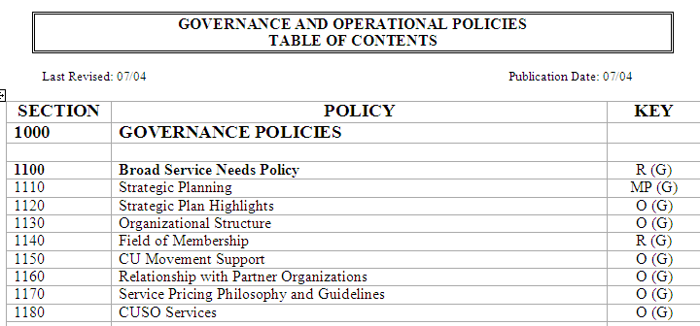
Ends Policies
Notes:
Dave elaborates….

Slide 43
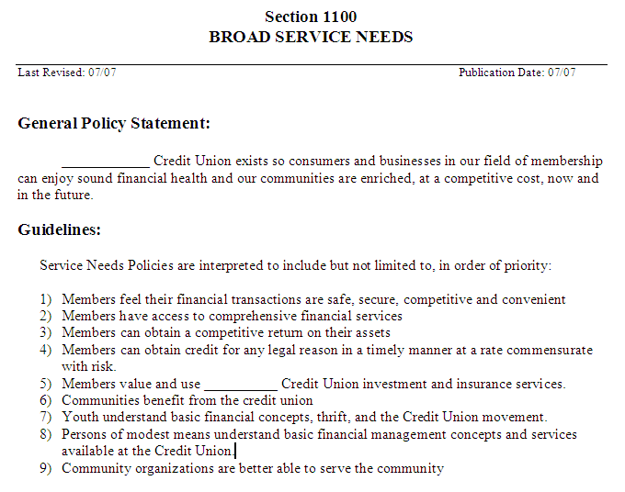
Sample “Ends” Policy
Notes:
Dave……

Slide 44
Executive Guidance/Limitations Policies
Manage between Rubber-stamping and Meddling
The Board must avoid the Enticement of Operations
The Board’s Interest: Effectiveness, Approvability, Legitimate Control of Means, Focus on Prudence and Ethics
Notes:
Manage between Rubber-stamping and Meddling
It is important to have balance here-board must have control over staff operations yet be free from the complexity and details of staff operations. If you are at one end of the spectrum you’re too permissive- a rubber stamping board. The other- your too involved…a meddling board.
Avoid the Enticement of Operations
Sometimes staff bring things to the board, other times a board member may have a particular interest or expertise in some level of operations. Either way, it is easy for a board to delve too deeply into the op’s pool which hinders governance efficiency. Be accountable for oversight, but make sure staff is accountable for decision making.
The Board’s Interest: Effectiveness, Approvability, Legitimate Control of Means, Focus on Prudence & Ethics
-Carver asserts that boards have more have a few interest in staff practices, and provides a unique mechanism for boards to control what needs to be controlled.
-Effectiveness-look at the ends more than the means…are we producing desired results?
-Approvability-it’s more effective to determine what you would disapprove-it’s not about “would I do it this way?”, but letting the CEO know what they can’t do.
-Legitimate control of means-board can’t ensure prudence and ethics by measuring attainment of ends. The board has a moral obligation to ensure operations are ethical and prudent.
This Category is Executive Limitations Policies
Executive limitations are policies that dictate what the executive can not do. Reasonably, the board does not have the time or expertise to list everything that should be done. It is more effective to state what can’t be done and state ahead of time what is imprudent and unethical.
Board Prescription of Means is “Anti-Innovative” and “Stultifying”
As I’ve mentioned before, board prescribing staff activities I stifles innovation and creativity.
Start Broad-to-specific and Large-to-small
Transform Worries Into Policies
As a board, what worries come to mind when you think of a CEO with unchecked full reign? Those are the policies you set- written in the negative, telling the CEO what they cannot do. Think nesting bowl again…large to small…all contained within the broad policy statement.
Limitation, Not Empowerment
Executive “Limitations”- again in the negative.

Slide 45
Executive Guidance/Limitations Policies
Start Broad-to-specific and Large-to-small
Transform Worries Into Policies
Limitations and Empowerment
Notes:
Manage between Rubber-stamping and Meddling
It is important to have balance here-board must have control over staff operations yet be free from the complexity and details of staff operations. If you are at one end of the spectrum you’re too permissive- a rubber stamping board. The other- your too involved…a meddling board.
Avoid the Enticement of Operations
Sometimes staff bring things to the board, other times a board member may have a particular interest or expertise in some level of operations. Either way, it is easy for a board to delve too deeply into the op’s pool which hinders governance efficiency. Be accountable for oversight, but make sure staff is accountable for decision making.
The Board’s Interest: Effectiveness, Approvability, Legitimate Control of Means, Focus on Prudence & Ethics
-Carver asserts that boards have more have a few interest in staff practices, and provides a unique mechanism for boards to control what needs to be controlled.
-Effectiveness-look at the ends more than the means…are we producing desired results?
-Approvability-it’s more effective to determine what you would disapprove-it’s not about “would I do it this way?”, but letting the CEO know what they can’t do.
-Legitimate control of means-board can’t ensure prudence and ethics by measuring attainment of ends. The board has a moral obligation to ensure operations are ethical and prudent.
This Category is Executive Limitations Policies
Executive limitations are policies that dictate what the executive can not do. Reasonably, the board does not have the time or expertise to list everything that should be done. It is more effective to state what can’t be done and state ahead of time what is imprudent and unethical.
Board Prescription of Means is “Anti-Innovative” and “Stultifying”
As I’ve mentioned before, board prescribing staff activities I stifles innovation and creativity.
Start Broad-to-specific and Large-to-small
Transform Worries Into Policies
As a board, what worries come to mind when you think of a CEO with unchecked full reign? Those are the policies you set- written in the negative, telling the CEO what they cannot do. Think nesting bowl again…large to small…all contained within the broad policy statement.
Limitation, Not Empowerment
Executive “Limitations”- again in the negative.

Slide 46
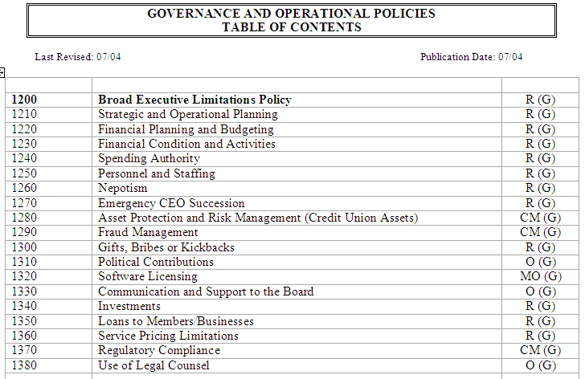
Examples of Executive Limitations Policies
Notes:
Dave elaborates on examples….

Slide 47
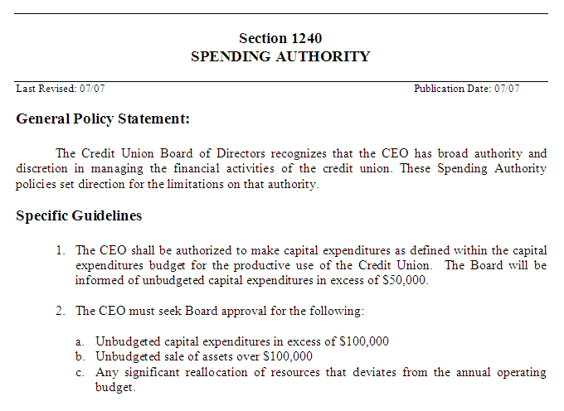
Sample “Executive Limitations” Policy
Notes:
Dave….

Slide 48
Strong Boards and Strong Executives
The Most Important Task of the Board
Defining a CEO
Trustees for the Membership
Board Holism – Accountability
The Board Has Only One Employee
Board Members and CEO are Colleagues
Notes:
The Most Important Task of the Board
No single relationship in the organization is as important as that between the board and its CEO-it can set the stage for effective governance or if poor, can have dire concequences.
Defining a CEO- the CEO puts all the pieces in place…all the functions of the organization. The CEO board relationship is critical, because if strength of one or the other is over powered, the organization suffers. It must be a balanced relationship with roles defined. A CEO must do what is necessary to ensure the job is done- to shoulder this much accountability, we need a strong CEO.
Nonprofits vest Chairman and CEO separately
Historically, in business corporations, entreprenuers gathered boards around them as their business grew. Publicly traded corporate boards often have one person in the role of CEO/Chair, yet it has been long recognized that a conflict of interest is present. Nonprofits separate these roles- which best serves the interest of owners.
Board Holism – Accountability
We are all responsible for our own behavior wherever we are. In a supervisory role, we have dual accountability – our own actions and actions of our subordinates. The burden of accountability goes up as you reach the top of organizational hierarchy. The CEO is accountable for the entire organization and performance of it’s people. As such the board need no official connection with staff members except at the CEO’s behest. The board does not need to dictate how the CEO got the job done, as long as it was done within executive limitations. Also, The board members and CEO are colleagues- the CEO reports to the board as a whole…not to individual members.
The Board Has Only One Employee
The CEO’s Work is Immaterial
Board Members and CEO are Colleagues

Slide 49
Monitoring Reports
The purpose of monitoring reports is to enable the board to know the degree to which a reasonable interpretation of its Ends and Executive Limitations Policies is being fulfilled.

Slide 50
Key Questions to Ask:
Has the CEO made a reasonable interpretation of our policies?
Does the data demonstrate accomplishment of that interpretation?

Slide 51
Guidelines for Good Monitoring
All limitations need to be monitored or they’re probably not limitations.
The board needs to decide who will do the monitoring: The Board, CEO or external 3rd Party.

Slide 52
Guidelines for Good Monitoring
The board needs to decide frequency of monitoring reports.
The board may bring more definition to monitoring, such as the types of information it needs to affirm that limitations aren’t exceeded.

Slide 53
Types of Monitoring Data
Internal Report- CEO discloses data to the Board. (The CEO Report)
External Report- A 3rd Party, selected by the Board/CEO collects the data.
Direct Inspection- Board collects the data. This method is rarely used.

Slide 54
When do we discuss the Report?
The Report doesn’t contain adequate data to convince the board that a reasonable interpretation of the policy is made.
The Report indicates the policy has been violated.

Slide 55
When do we discuss the Report?
The board questions the integrity of the data presented.
If, by the nature of the report, the board realizes it wrote an inappropriate policy.

Slide 56
What to record in the Minutes:
Record in the minutes a motion that the board assessed the Monitoring Report and found it provided evidence of compliance with a reasonable interpretation of the policy.
OR….

Slide 57
What to record in the Minutes:
Record in the minutes a motion that the board assessed the Monitoring Report and found it didn’t provide evidence of compliance with a reasonable interpretation of policy. Specify the board expectations of compliance.

Slide 58
Sample Monitoring Schedule
Financial Condition
Asset Protection
Treatment of Staff
Support of Board
Financial Planning
Internal - Quarterly
Internal – Semi-Annually
Internal – Annually
Direct Inspection- Semi
External- Annually

Slide 59
What if we’re Non-Compliant?
Do Nothing.
Increase Monitoring frequency.
Agree with the CEO on a realistic timeframe to correct the problem.
Change policy expectations.
Take disciplinary action.

Slide 60
Board Job Description
Reports to: Members
Works in Partnership with: President/CEO
Primary Function- To set policy, plan the credit union’s course, make sure the credit union maintains its sound financial condition, keep communication open to educate members on services, review the CEO’s progress in achieving goals and objectives, and report to the members at the annual meeting.

Slide 61
Board Job Description- Board/CEO Team
Board: Idea Decisions:
Give Direction
Determine Objectives
Establish Policies
Approve Goals
Coordinate Directors
Approve Long Range Plans
CEO Succession
Analyze Key Performance
Manage CEO Growth
CEO: Action Decisions:
Direct
Carry Out Objectives
Implement Policies
Propose Goals
Coordinate Operations
Propose Long Range Plans
Employee Succession
Control Key Indicators
Manage Staff Growth

Slide 62
Board Job Description- Board/CEO Team
What are the key elements in good CEO Board relationships?
Trust between the CEO and the Board
Lack of Micromanaging
Clarity of each others Leadership role
Communication

Slide 63
Keeping the Roles Separate
Executive Recommendations
Intrusions by the Board
Mutual Expectations
Board-Management Delegation
Notes:
Dave…..

Slide 64
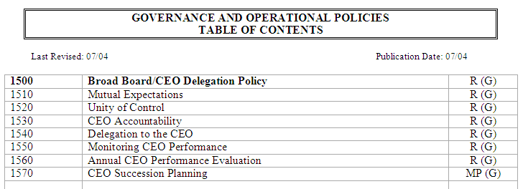
Board-CEO Relationship Policies
Notes:
Dave….

Slide 65
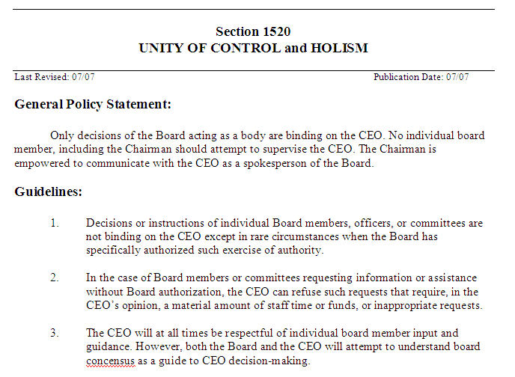
Sample Board-CEO Policy:
Notes:
Dave…..

Slide 66
Board Accountability
The Moral Ownership
The Board’s Responsibility for Board Performance- Self Evaluation
Diversity and Dynamics
Board Products: A Job Description, Explicit Governing Policies and Assurance of Organizational Performance
Notes:
The Moral Ownership-owners can be challenging to define for some non profits, but with credit unions, the owners are the members. There can be overlapping roles- as board members and staff can be a member of the credit union. However, look at the moral ownership as the collective membership of the credit union. The board is accountable to this owner.
The Board’s Responsibility for Board Performance
This is the board’s job- to govern as efficiently and effectively in the interest of the moral ownership. The board is responsible for it’s own development, discipline, job design and performance.
Diversity and Dynamics
This is a team- with different players. There are dynamics to recognize such as that not everyone is going to have the same communication, learning or coping style. This presents challenges. People will be from different walks of life. Also can present challenges, but if the roles and rules are defined, the team should be able to benefit from these differences. We don’t want an entire board of Type A’s- or an entire board of CPA’s…diversity will help drive discussion and differing perspectives.
Board Products: A Job Description, Explicit Governing Policies and Assurance of Organizational Performance
Carver details a board job description, policy and assurance of organizational performance.

Slide 67
Basic Board Job Description
Linkage to the Ownership
Explicit Governance Policies
Assurance of Organizational Performance
Other Duties (Fundraising, public image, legislative impact, etc.)
Notes:
Linkage to the Ownership
The board acts in trusteeship and serves as the legitimizing connection between this base and the organization.
Explicit Governance Policies
The values of the entire credit union are encompassed by the board’s explicit enunciation and proper categorization of broad policies.
Assurance of Organizational Performance
Though the board doesn’t do staff’s job, it must ensure that the staff as a total body meets the criteria the board has set.
Other Duties (Fundraising, public image, legislative impact, etc.)
If a board wishes to establish additional job products, they must be reflected in the job description.

Slide 68
Divisions of Labor:
Chief Governance Officer
Chief Executive Officer
Notes:
The CGO is the board chairperson-the leader of the board’s processes on behalf of the board.

Slide 69
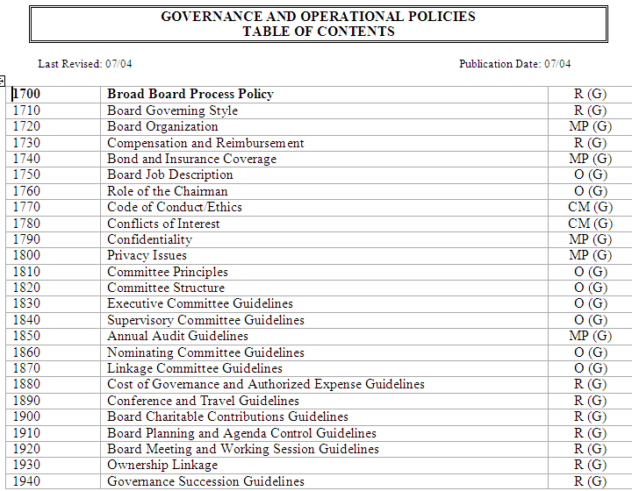
Board Governance Process Policies:
Notes:
Dave….

Slide 70
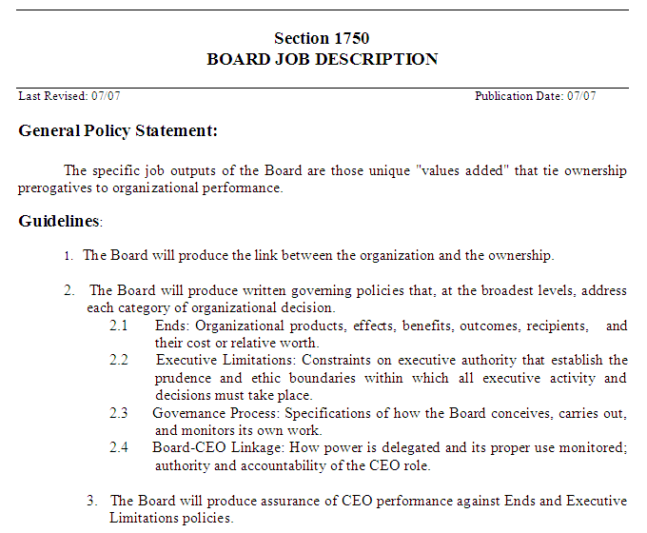
Board Governance Process Policy:
Notes:
Dave…..

Slide 71
Maintaining Board Leadership
Be Obsessed with Effects for People
Invigorate the Ends Debate
Drive Ends Dialogue Beyond the Boardroom
Invest in Selection & Training
Recruit Those Who Can and Will Govern
Commit to Structured Practice
Make Self-Evaluation a Regular Event
Notes:
Be Obsessed with Effects for People- you are here to benefit the membership- that should always be your primary focus
Invigorate the Ends Debate-this may the most exciting part of your job as board members- ends dialog should not be boring and your board has diverse ideas
Drive Ends Dialogue Beyond the Boardroom-reach out to other boards – take the opportunity to do so at events such as these
Don’t Be Seduced by Cost Control- you need to be effective and efficient- cost conscientus. Focus on quality and what is going to best benefit your membership
Keep Trusteeship Up Front- you serve the membership so be servant leaders
Respect your Words- say what you mean and mean what you say- a bit more difficult as a group, but use fewer words that are meaningful both in board meetings and certainly in creating documents like End and Executive Limitations
Invest in Selection & Training
Skills fade, previous training needs to be reinforced. Board members have much to learn and relearn about teamwork and exercising group authority
Recruit Those Who Can and Will Govern
Commit to Structured Practice-go back to the book or manual and practice elements of governance. Winning teams in sports do not win by showing up. You have to commit some time to structured practice.
Make Self-Evaluation a Regular Event- evaluate yourselves against predetermined criteria regularly. Evaluate board behavior and achievement.

Slide 72
Does your Credit Union need this?
Cutting-Edge Board Governance
Carver model is for the best of today’s boards, not just for struggling ones.
Why is it relevant to today’s credit unions?
It makes good credit unions great and great credit unions even better.
It allows you to produce what Members want from their credit union.

Slide 73
Chip Filson, CEO-Callahan and Associates on Carver Board Governance:
Cutting-Edge Board Governance
“ As credit unions move away from their historical field of memberships to broader community charters, boards can be key contributors connecting with new SEGS and Members. Most importantly the board can help management focus on the best long-term strategic priorities.”

Slide 74
How do I take advantage of Carver Board Governance?
Cutting-Edge Board Governance
Learning and Preparation phase
Make the decision to improve and succeed
Set a date for Governance retreat & meeting
Prepare Policies (Governance Pro)
Start using Governance with a “Blitz” meeting
Refine and improve as needed
Enjoy the benefits of improved Governance!

Slide 75
        Presented by:
        Mike Moyes
        CUcorp/MCUL
        mike.moyes@cucorp.com
        May 20th, 2010

